Slide 1

Your Sixth Sense for Success
6SENSE
WE ARE
PROJMAN 2024

Slide 2





S5WLJCC-RMS
PROPOSAL
Shrine of the Five Wounds of the Lord Jesus Christ Chruch Request Management System

Slide 3
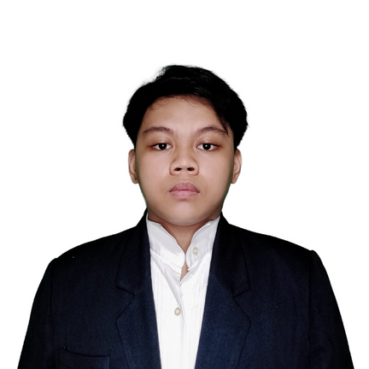
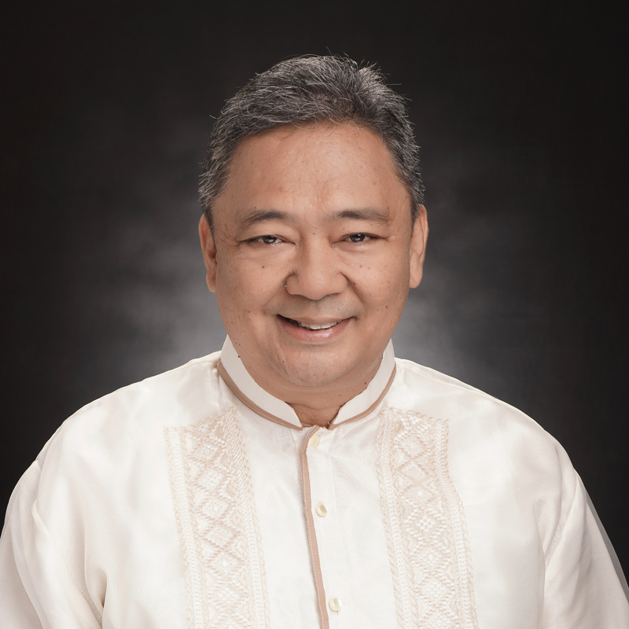
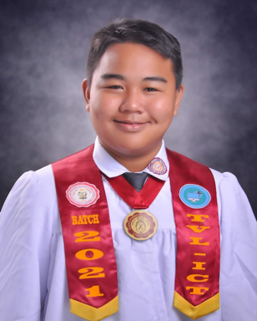
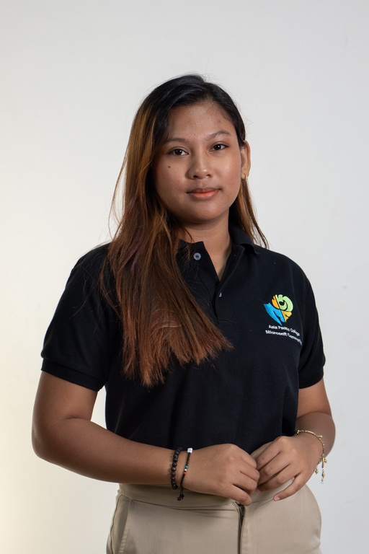
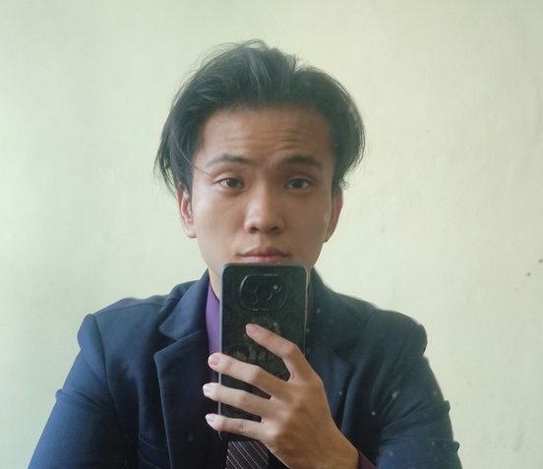
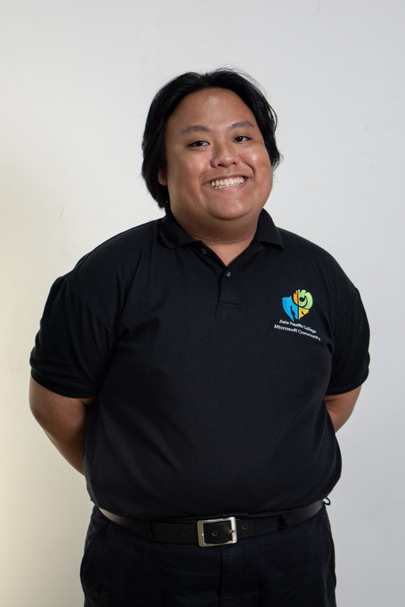
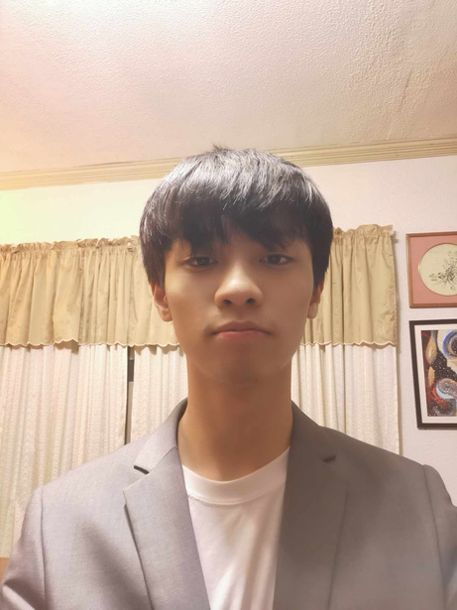
Reiner Gena
Alvin Limpin
Bon Daggao
Scrum Master & Document Specialist
Adviser
Project Manager & Developer
Kimberly Altea
Vince Edward Tan
Jarvis Carpo
Carlo Santos
Designer & Developer
Document Specialist & Developer
Developer & Client Coordinator
Developer & Document Specialist

Slide 4
6SENSE
2024
Table of Content
Client Context | 01 | Work Breakdown Structure | 06
Problem Statement | 02 | Project Cost Estimate | 07
Objectives | 03 | Change Control Board | 08
Project Milestone | 04 | Communication Matrix | 09
Stakeholder Register | 05 | Risk Analysis | 10

Slide 5
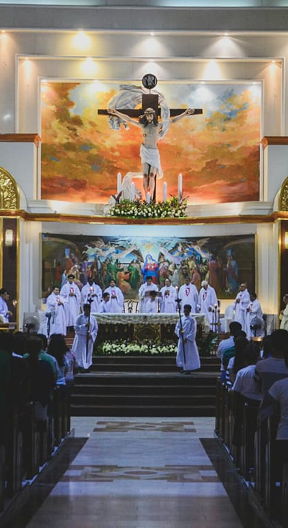

6SENSE
2024
Client Context
Shrine of the Five Wounds of Our Lord Jesus Christ
Catholic Church
Established in 1985
Las Pinas City, Metro Manila
Product/Services
Marriage & Baptismal Certificates
Wedding
Confirmation
Counseling
Mass Intentions
House Blessing
Anointing
Mass Cards
Facebook Page
Regularly social media posting
Manual Process
Pen & Paper
Fr. Jerson Avelino
Church Admin
Ms. Princess Malatag
Parish Scretary
Jarvis Carpo
Developer & Client Coordinator

Slide 6
6SENSE
2024
Problem Statement
General Problem:
The Shrine of Five Wounds of Our Lord Jesus Christ Parish has difficulty managing its services due to being a one-woman job in the church.
Specific Problem:
Current scheduling process for services and document requests involves back-and-forth interactions between staff and clients.
The secretary's reliance solely on a physical bulletin board and logbook for tracking the Priest's schedules limits accessibility and increases the chance of scheduling conflicts.
There is no effective way to inform the Priest of their upcoming schedules or to inform clients of the status of their requests, which could result in schedule misinformation.
Bon Gryan Daggao
Project Manager & Developer

Slide 7



6SENSE
2024
Objectives
The team's main objective is to develop a web-based Request Management System for The Shrine of Five Wounds of Our Lord Jesus Christ Parish. Specifically, the system aims to:
Reduce the overall time spent by the staff
To lessen scheduling conflicts
To minimize misinformation
Reiner Gena
Scrum Master & Document Specialist
Notes:
To reduce the overall time spent by the staff to schedule and process a service or document request depending on the type of service or document being requested by simplifying the scheduling process.
To lessen scheduling conflicts and the amount of time needed to schedule and manage Priest activities by improving the accessibility of the Priest schedule.
To minimize misinformation and ensure that the Priest and clients are informed about their schedules or requests status by optimizing how notifications are received.

Slide 8
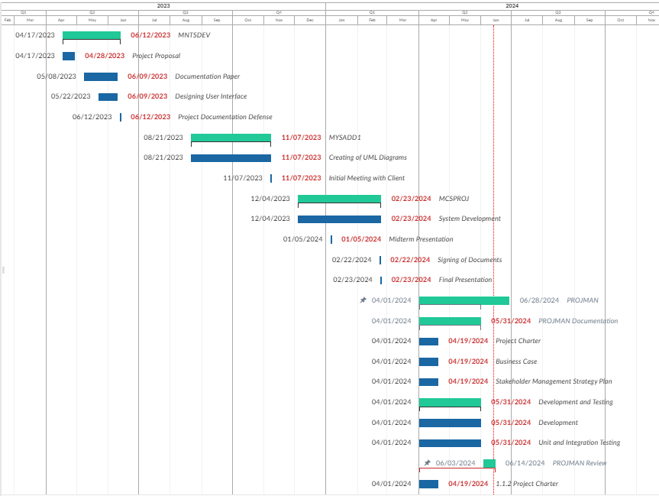
Project Milestones
Jarvis Carpo
Developer & Client Coordinator

Slide 9
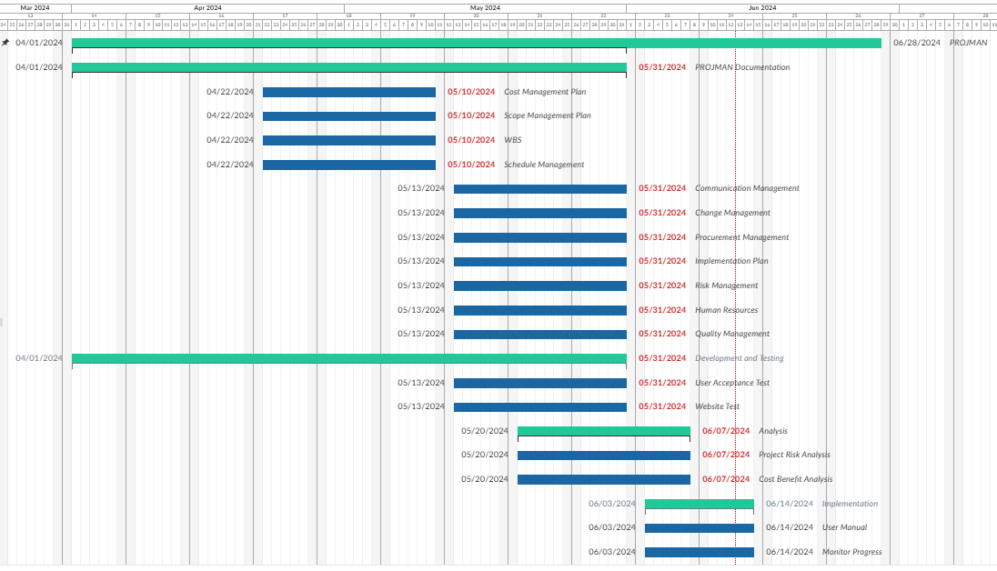
Jarvis Carpo
Developer & Client Coordinator

Slide 10
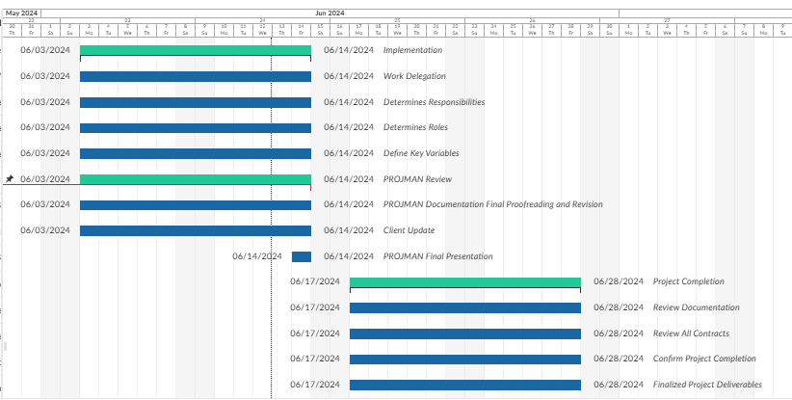
Jarvis Carpo
Developer & Client Coordinator

Slide 11
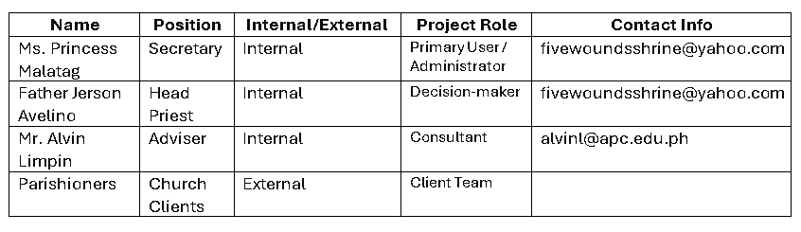
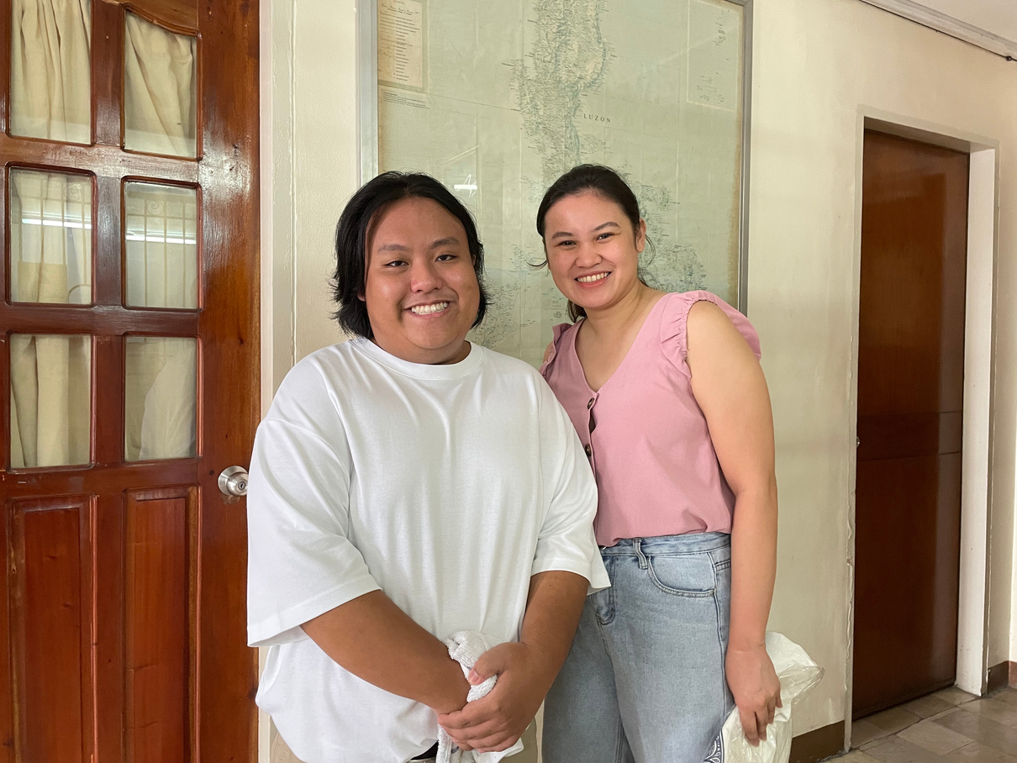
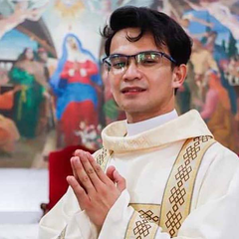
6SENSE
2024
Stakeholder Register
Ms. Princess Malatag
Fr. Jerson Avenido
Parish Secretary
Church Admin
Kimberly Altea
Designer & Developer

Slide 12
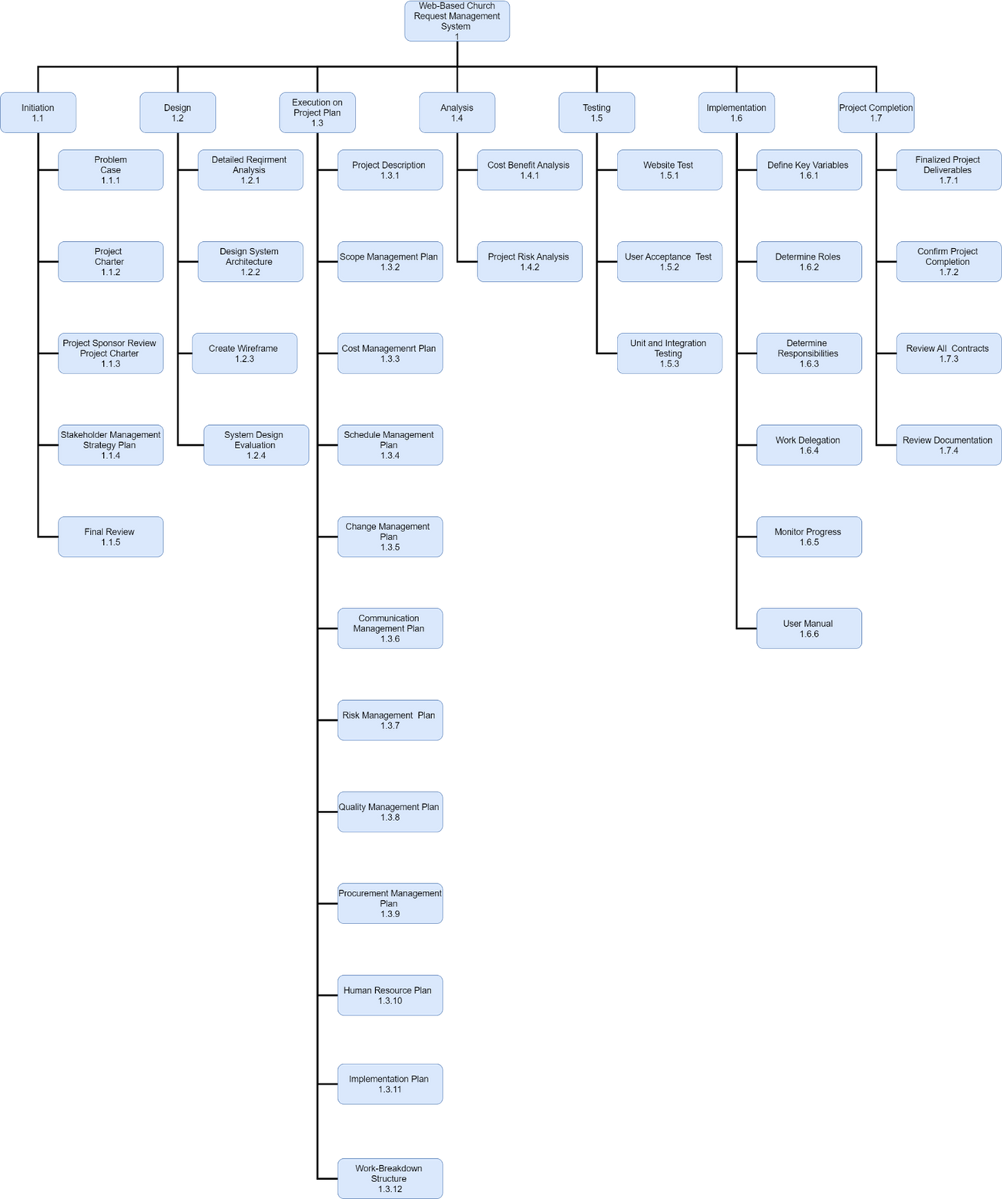
6SENSE
2024
Carlo Santos
Developer

Slide 13
6SENSE
2024
Project Cost Estimate
Total Budget =
Contingency Cost (10% of Estimated Cost)
+ Estimated Cost
Vince Edward Tan
Document Specialist & Developer

Slide 14
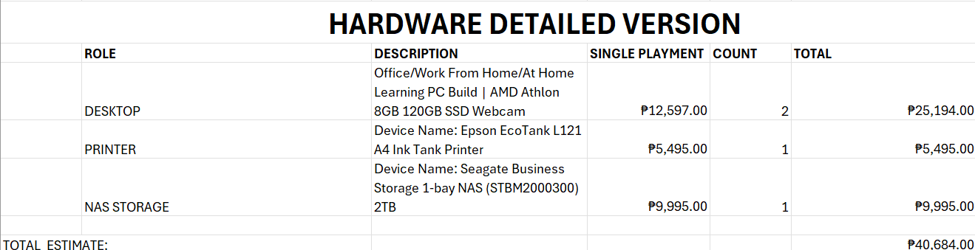
6SENSE
2024
Project Cost Estimate
Vince Edward Tan
Bon Gryan Daggao
Document Specialist & Developer
Project Manager & Developer

Slide 15
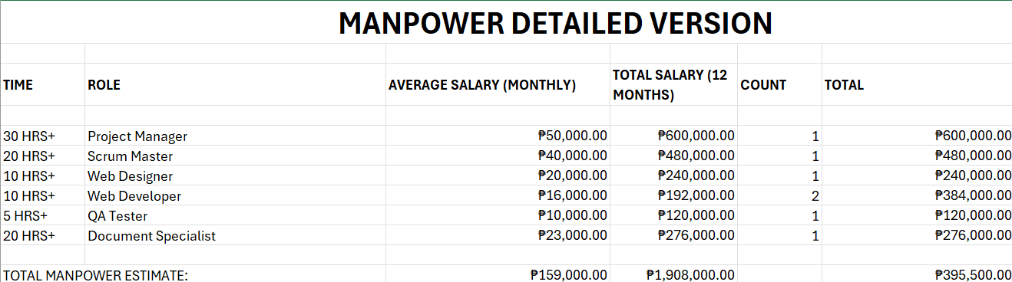
6SENSE
2024
Project Cost Estimate
Vince Edward Tan
Bon Gryan Daggao
Document Specialist & Developer
Project Manager & Developer

Slide 16
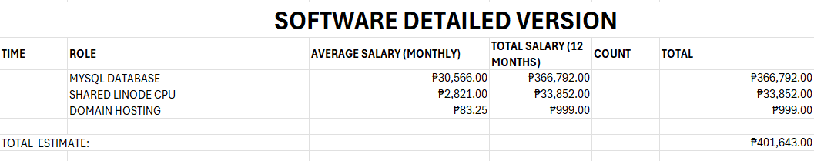
6SENSE
2024
Project Cost Estimate
Vince Edward Tan
Bon Gryan Daggao
Document Specialist & Developer
Project Manager & Developer

Slide 17
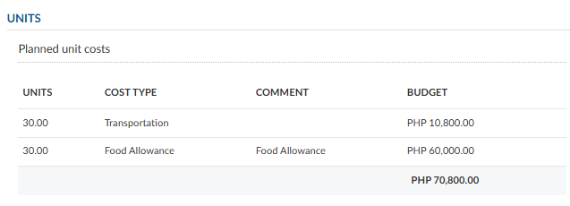
6SENSE
2024
Project Cost Estimate
Vince Edward Tan
Bon Gryan Daggao
Document Specialist & Developer
Project Manager & Developer

Slide 18
6SENSE
2024
Project Cost Estimate
Estimate
₱ 908,627.00
Contingency Cost
₱ 90,862.70
Overall Estimate
₱ 999,489.70
Vince Edward Tan
Document Specialist & Developer

Slide 19
6SENSE
2024
Change Control Board
Role and Responsibilities
Project Sponsor and Project Manager:
Oversee and evaluate change requests, ensuring prompt and accurate management.
Verify reports and logs to reflect all changes correctly.
Collaborate on impact assessments and approve high-impact changes.
Scrum Master:
Ensure adherence to Scrum practices and timely deliverables.
Ensure the quality and scope alignment of team members' documents.
Name | Position
Princess Malatag | Project Sponsor
Bon Gryan Daggao | Project Manager
Reiner Gena | Scrum Master
Kimberly Altea
Designer & Developer

Slide 20
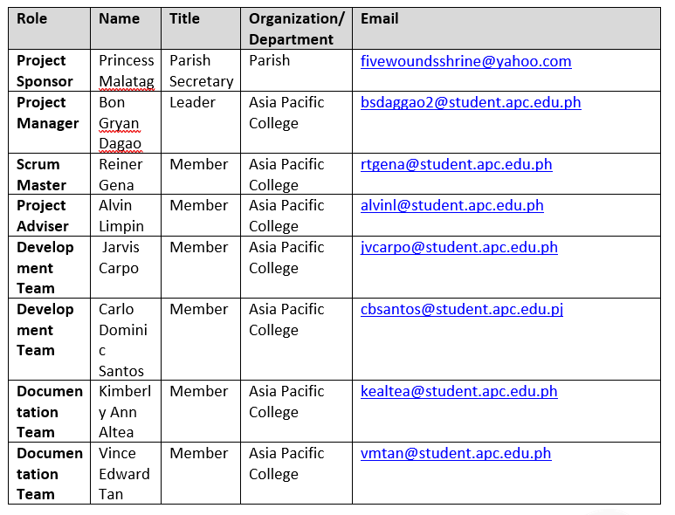
6SENSE
2024
Communication Matrix
F2F Meetings
Daily Scrum
MS Teams
TeamBox
Jira
Bon Gryan Daggao
Project Manager & Developer

Slide 21
6SENSE
2024
Risk Analysis
Data Security Breach
Loss of Data Challenges
Carlo Santos
Developer

Slide 22
6SENSE
2024
Contributions
Jarvis Carpo
Reiner Gena
Kimberly Altea
Developer & Client Coordinator
Scrum Master & Document Specialist
Designer & Developer
Project Charter
Communication Management Plan
Quality Management Plan
Stakeholder Management Plan
Project Charter
Business Case
Scope Management Plan
Work Breakdown Structure
Quality Management Plan
Implementation Plan
Stakeholder Management Plan
Change Management Plan
Procurement Management Plan
Human Resources Management Plan
Carlo Santos
Bon Daggao
Vince Edward Tan
Developer
Project Manager & Developer
Document Specialist & Developer
Business Case
Risk Management Plan
Procurement Management Plan
Business Case
Schedule Management Plan
Risk Management Plan
Communication Management
Work Breakdown Structure
Cost Management Plan
Human Resources Management Plan
Implementation Plan

Slide 23
S5WLJCC-RMS
PROPOSAL
Shrine of the Five Wounds of the Lord Jesus Christ Chruch Request Management System

Slide 24
6SENSE
WE ARE
PROJMAN 2024

